Slide 1

Analysis of 10x scRNA - Seq data
Transcriptomics
Leonardo Nossa
Leonardo.nossa@student.unimi.it

Slide 2
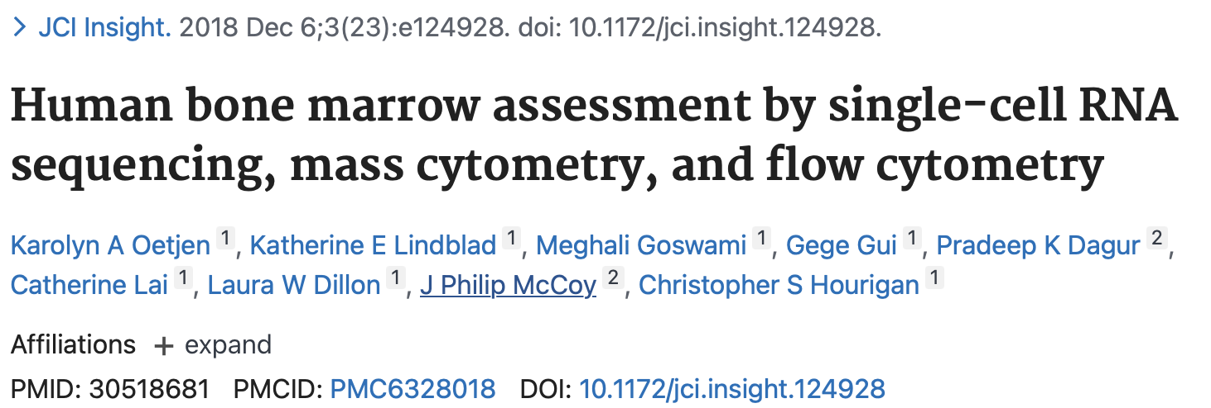
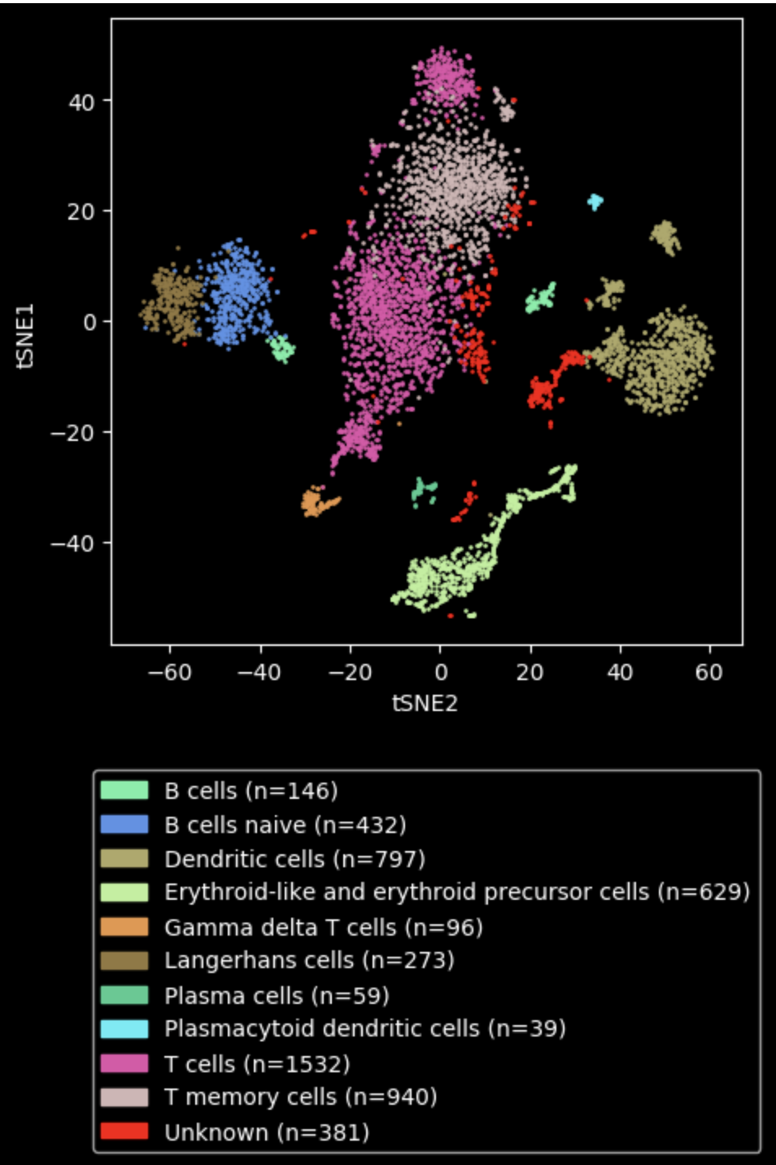
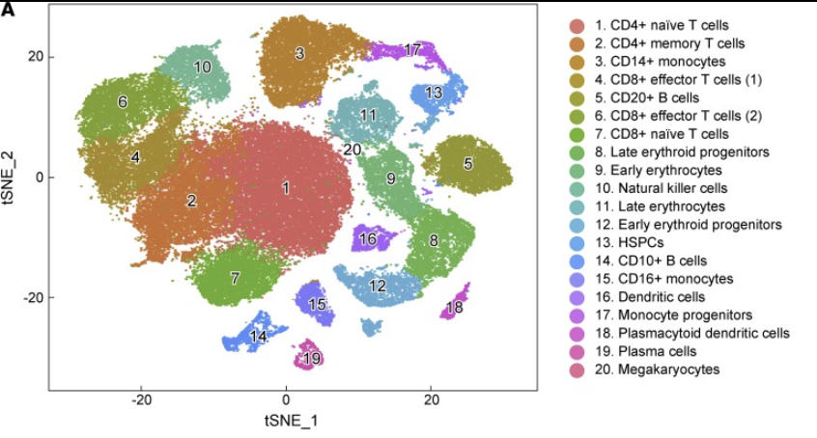
Source material
Some of putative gene markers founded is the study
HBD
Erythroid cells
NKG7
Natural Killer Cells
CD79A
CD10+ B cells
CD3D
T cells

Slide 3
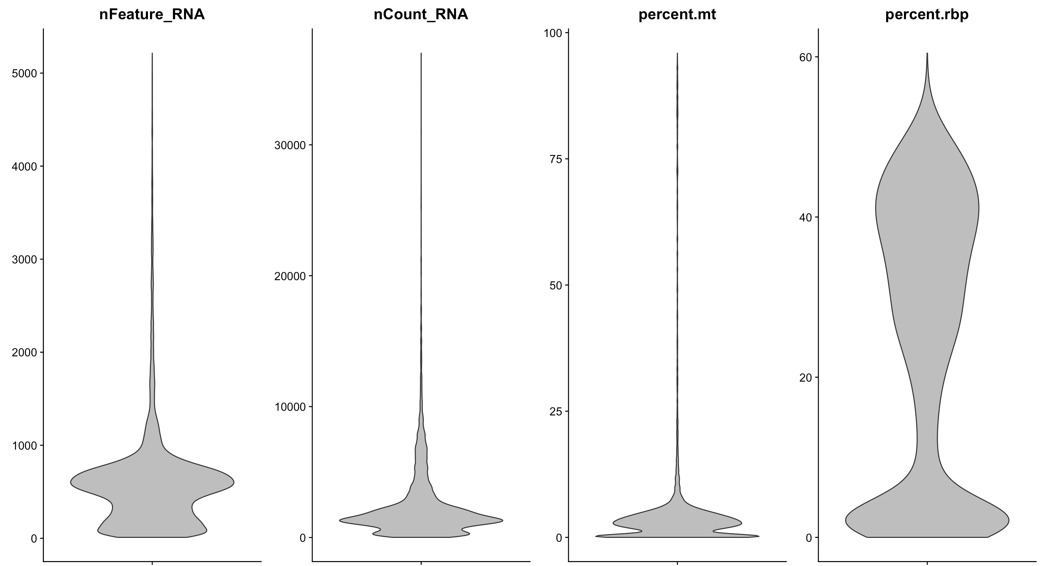
Cell quality control
Starting data: 8067 samples
Filter cells based on “bad quality" criteria:
> 200 genes(probably empty droplets)
< 2500 genes(probably doublets)
< 5% mitochondrial gene content
(cell might be under stress)
Filtered data: 6474 samples

Slide 4
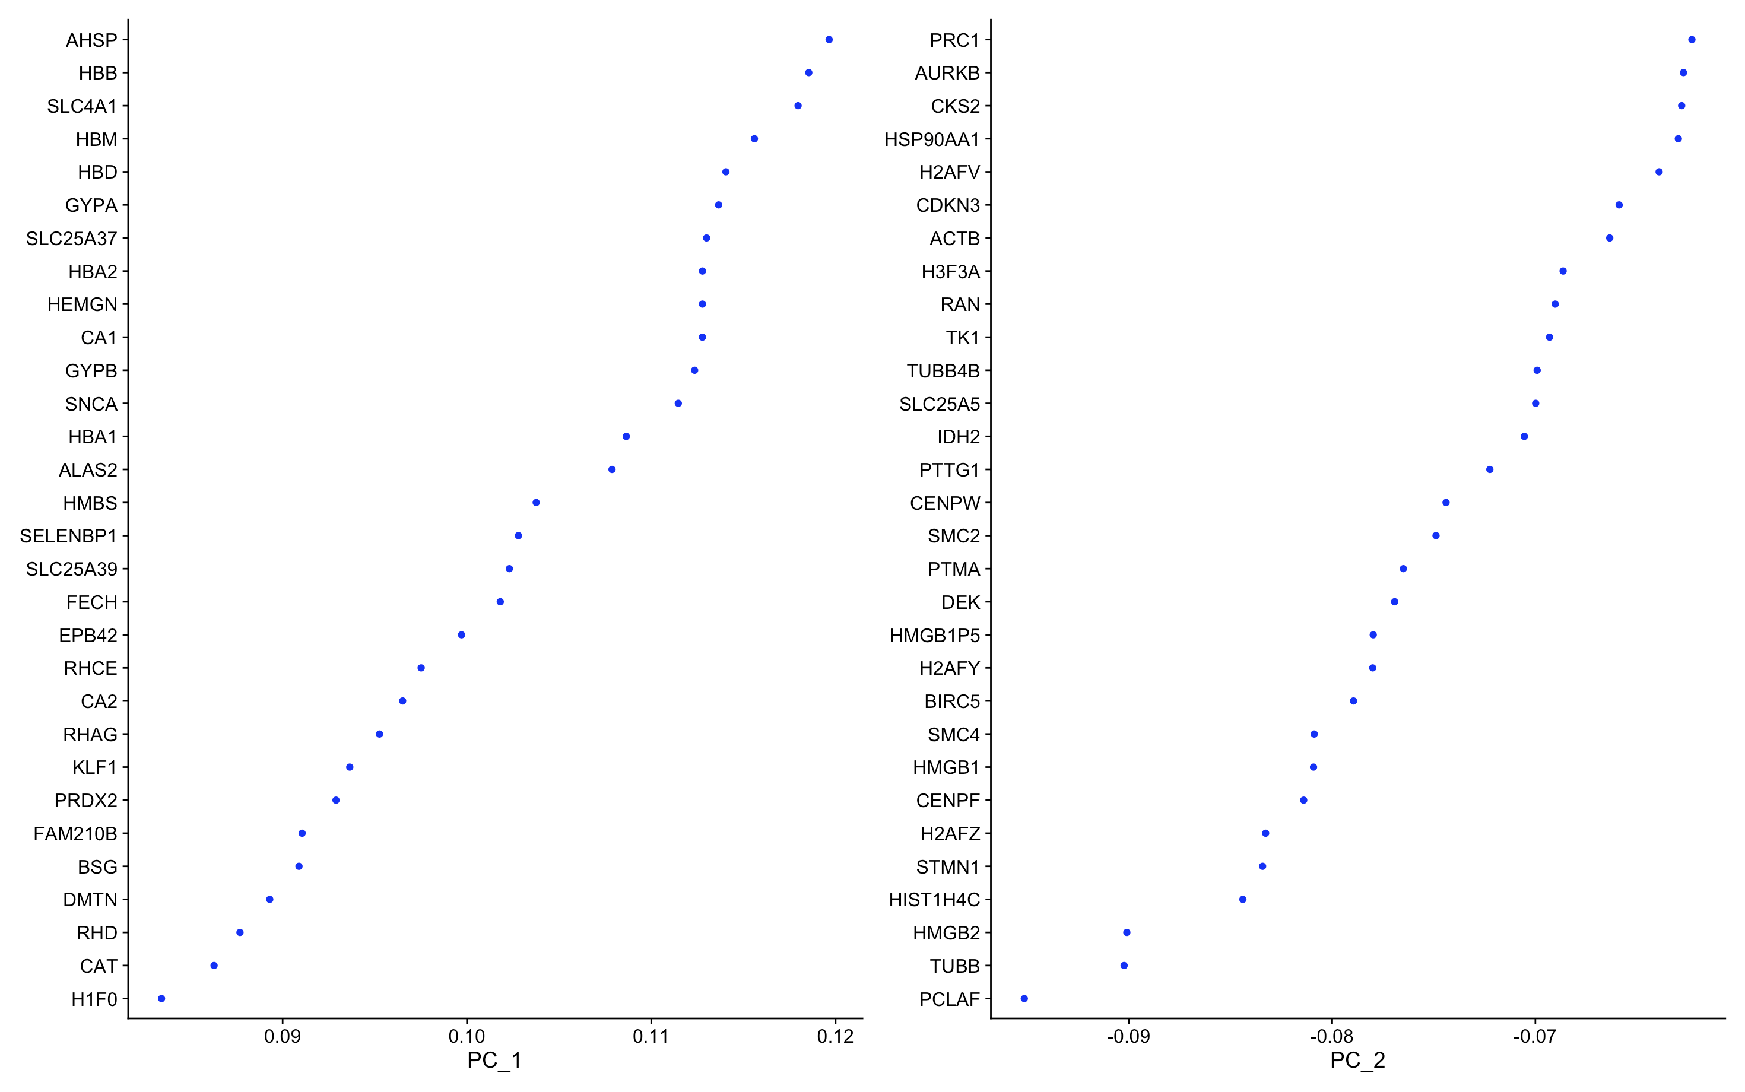
Most variable genes reported for the first two components
HBB
Erythroid cells
HBD
Erythroid cells
HBA1
Erythroid cells
HBA2
Erythroid cells
PRC1
HSC

Slide 5
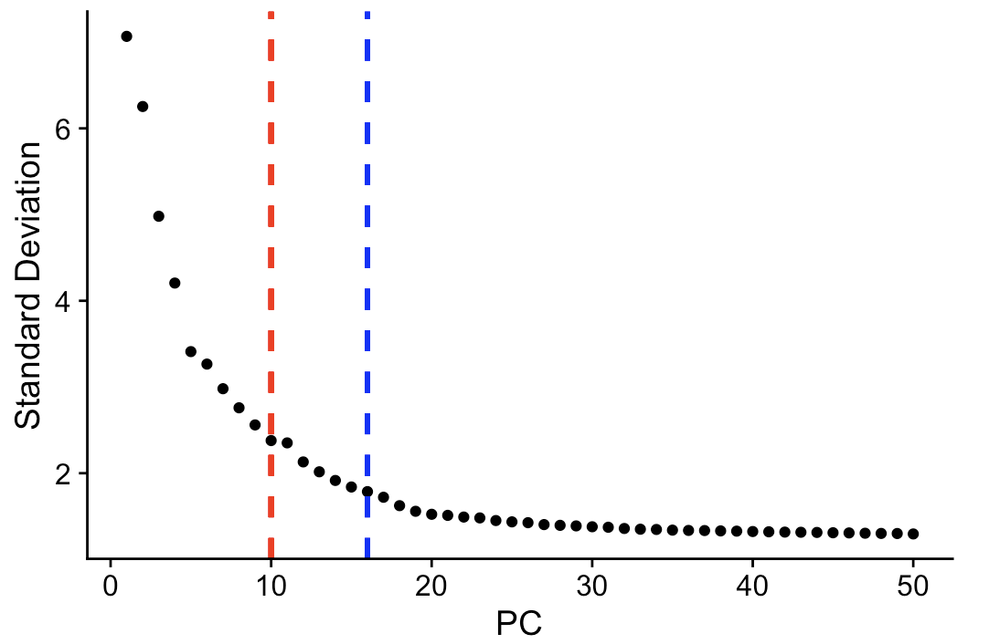
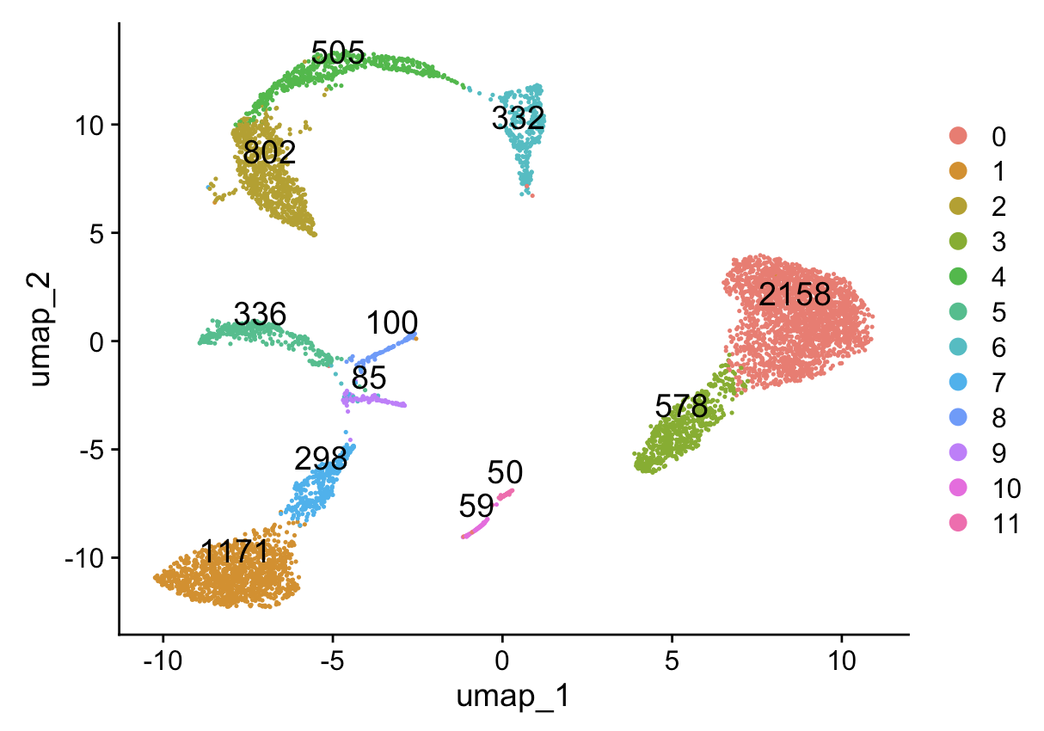
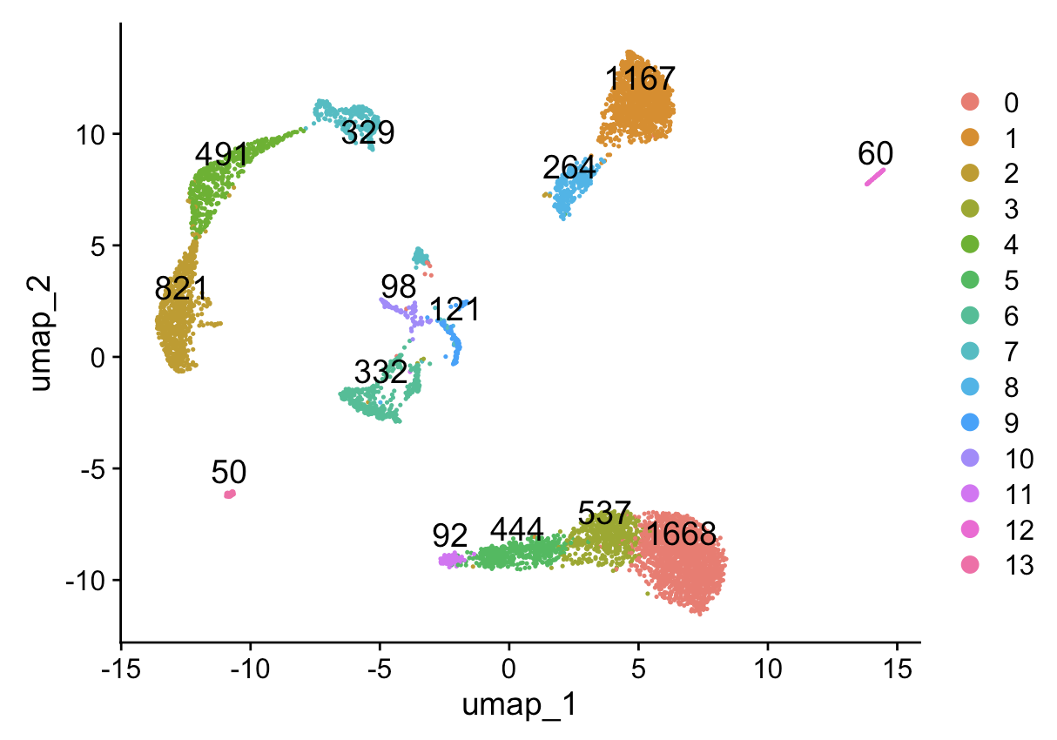
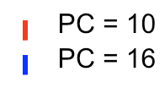
PCA and Clustering
The analysis was, initially, done with number of PCs = 10
(BUT)
the number of PCs that explains 75% of the variance = 16
This is the resulting UMAP instead of using PC = 10
Obtained 12 clusters
This is the resulting UMAP instead of using PC = 16
Obtained 14 clusters

Slide 6
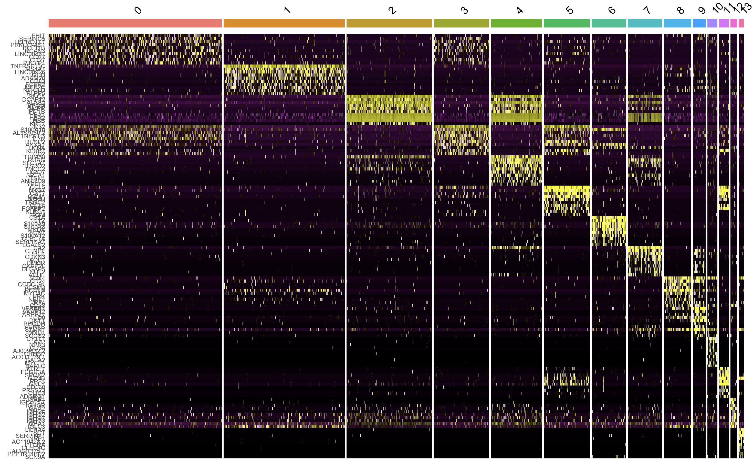
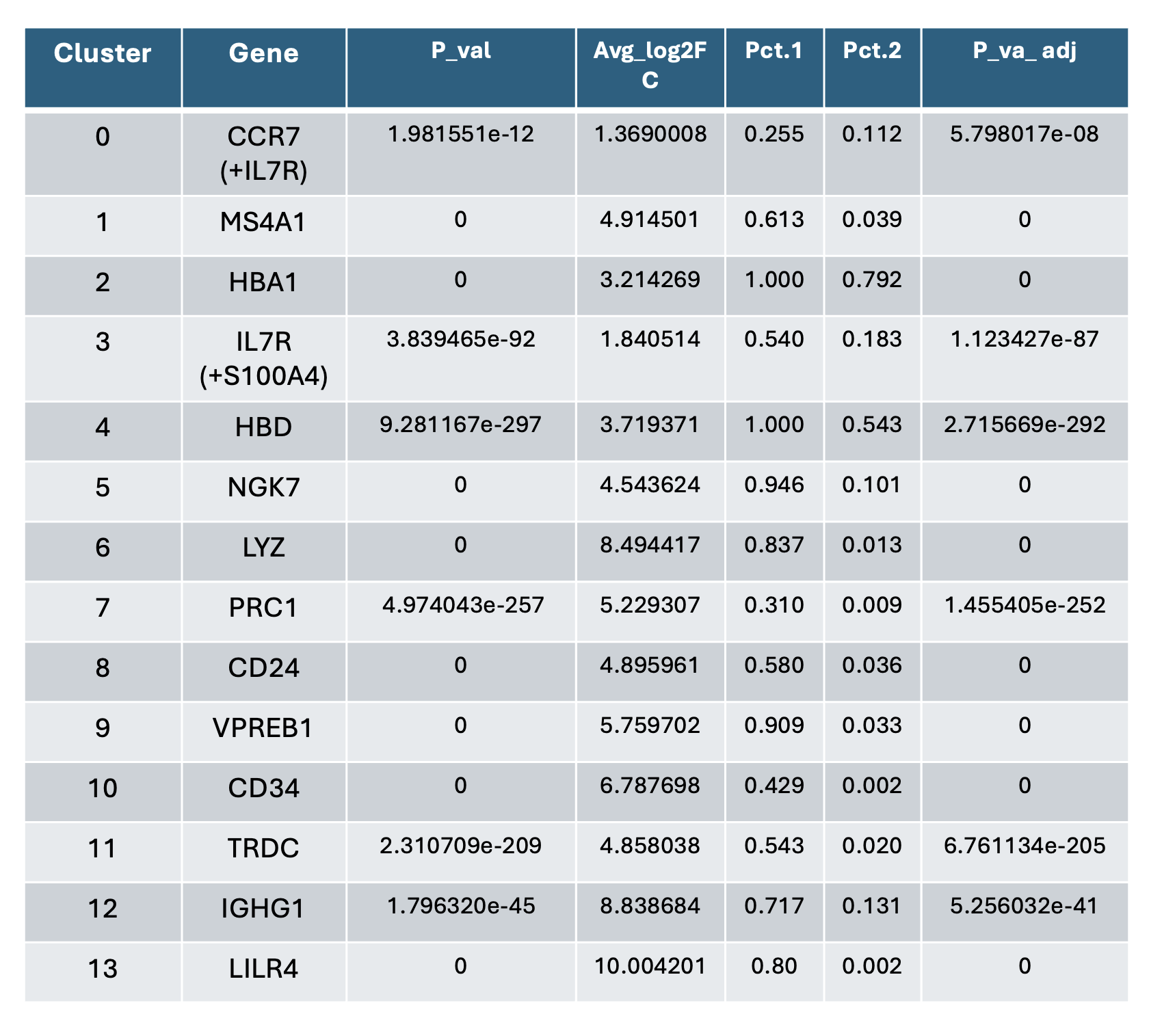
Marker genes
The “+” refers to take in consideration the second gene to identify the cell

Slide 7
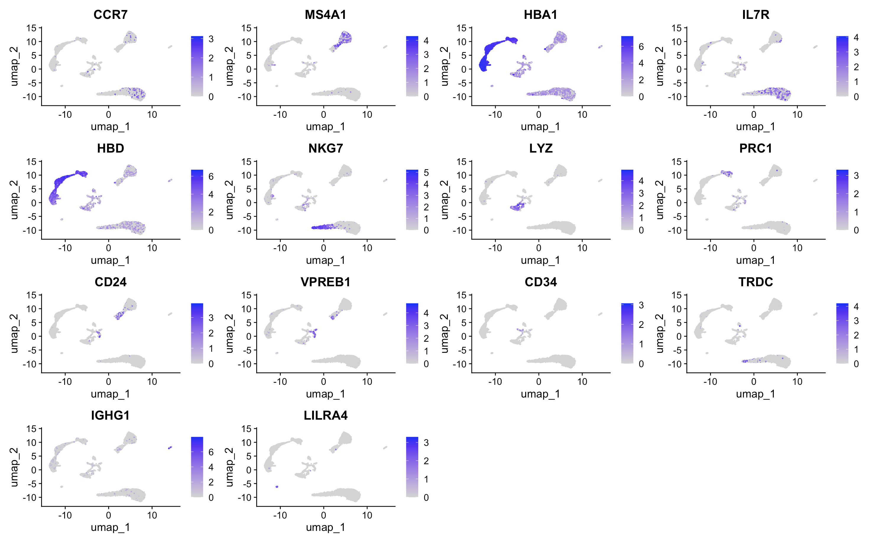
Marker genes
The “+” refers to take in consideration the second gene to identify the cell

Slide 8
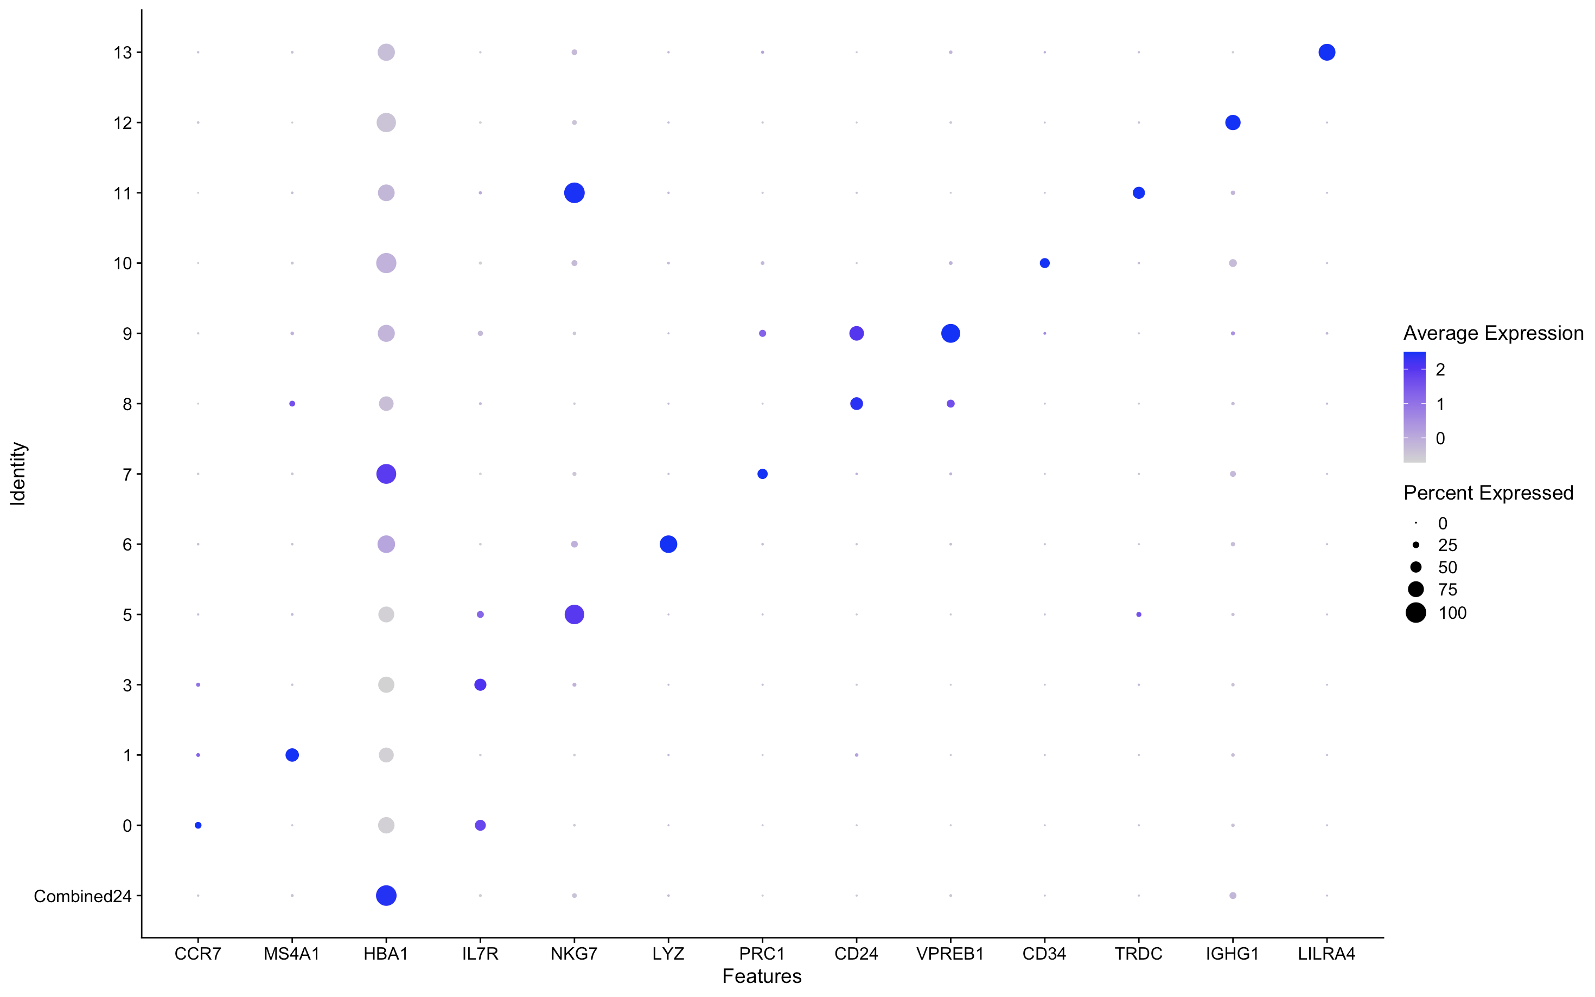
Marker genes
The “+” refers to take in consideration the second gene to identify the cell

Slide 9
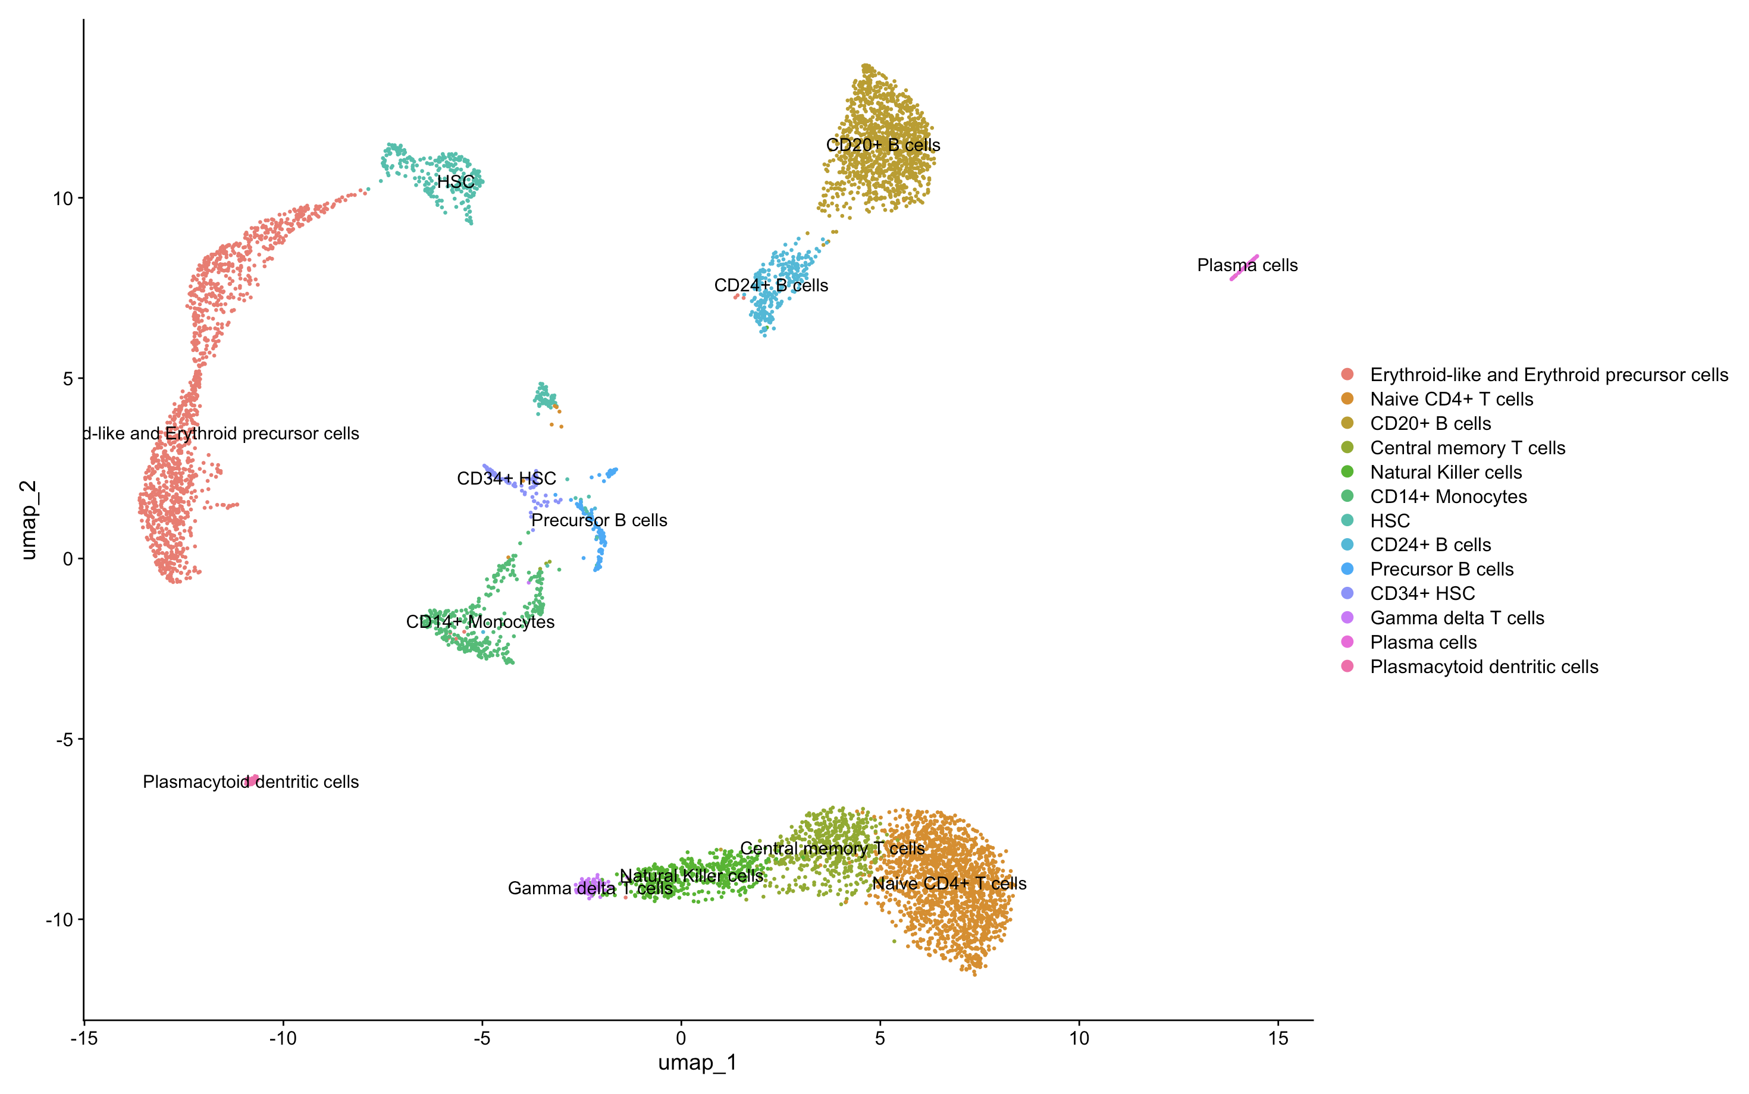
Final result

